Slide 1

DEPARTMENT OF COMPUTER SCIENCE & ENGINEERING (DATA SCIENCE)
“PHISHING ATTACK DETECTION”
COURSE NAME : MINI PROJECT COURSE CODE: 22CDS58
Presentation by,
NAME-Bhoomika G M
USN -1NH22CD131
NAME-Shreya Venugopal
USN -1NH22CD135
Under the Guidance of,
Guide Name- Ms. Anchal
Designation- Assistant professor

Slide 2
Agenda
Introduction
Problem Definition
Proposed system
Objectives
Flowchart
Design modules
Implementation
Demonstration
Conclusion
References

Slide 3

Introduction
Phishing attacks have become a significant concern in today’s digital age, posing threats to individuals and organizations by exploiting vulnerabilities in online communication. These attacks often impersonate trusted entities to deceive users into sharing sensitive information such as passwords, credit card details, and personal data. As phishing techniques become more sophisticated, detecting and preventing these attacks has become a critical challenge.
This project aims to address this issue by developing an efficient phishing attack detection system. By leveraging a combination of advanced feature extraction methods and machine learning algorithms, this system is designed to identify phishing attempts based on patterns in urls, domain behaviour, and content structure.

Slide 4
Literature Survey
Machine Learning-Based Detection- ML algorithms, including decision trees, support vector machines, and neural networks, have shown strong performance in identifying phishing websites. Abdelhamid et al. (2014) used a random forest classifier to detect phishing URLs based on features like URL length and domain characteristics. Deep learning models, such as those used by Le et al. (2018), also achieved high accuracy by capturing sequential patterns in URLs.
URL and Domain-Based Analysis-URL analysis, examining features like URL length, IP usage, and domain registration data, has been effective for phishing detection. Ma et al. (2009) demonstrated an ML approach to classify URLs, with high accuracy in identifying phishing websites through suspicious patterns and newly registered domains.

Slide 5
Problem Definition
Widespread Phishing Threat: Phishing attacks are a major cybersecurity concern, targeting users to steal sensitive information like passwords and financial details.
Evolving Attack Techniques: Phishing methods are becoming more sophisticated, making traditional detection methods ineffective.
Limitations of Current Systems: Existing detection systems rely on outdated techniques or manual intervention, which fail to identify new phishing strategies.
Need for Automated Detection: There is a need for an automated system that can accurately identify phishing attacks in real time, reducing the risk of data breaches and financial losses.
Minimizing False Positives: The challenge is to develop a solution that accurately detects phishing attempts while minimizing false positives.

Slide 6
Objectives
The main objective behind this project is to provide a robust solution to one of the most pressing cybersecurity issues. A reliable phishing detection mechanism not only helps in protecting user data but also enhances trust in online platforms. This project emphasizes both the technical aspects and real-world applicability, contributing to the broader goal of making the internet a safer place.
To develop a machine learning-based system for detecting and classifying phishing attacks by analyzing website features such as URLs, domain names, and content. The project aims to improve detection accuracy, minimize false positives, and create a scalable, automated solution to enhance cybersecurity, protect users, and prevent data breaches and financial losses.

Slide 7
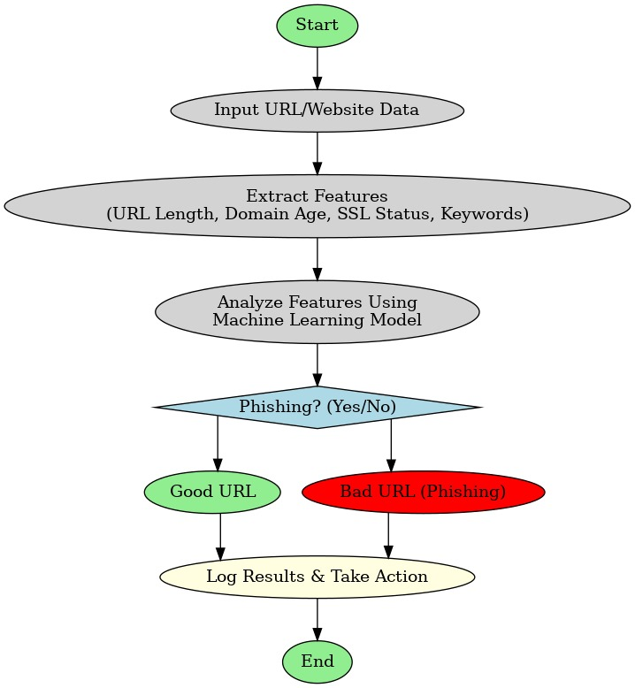
Flowchart

Slide 8
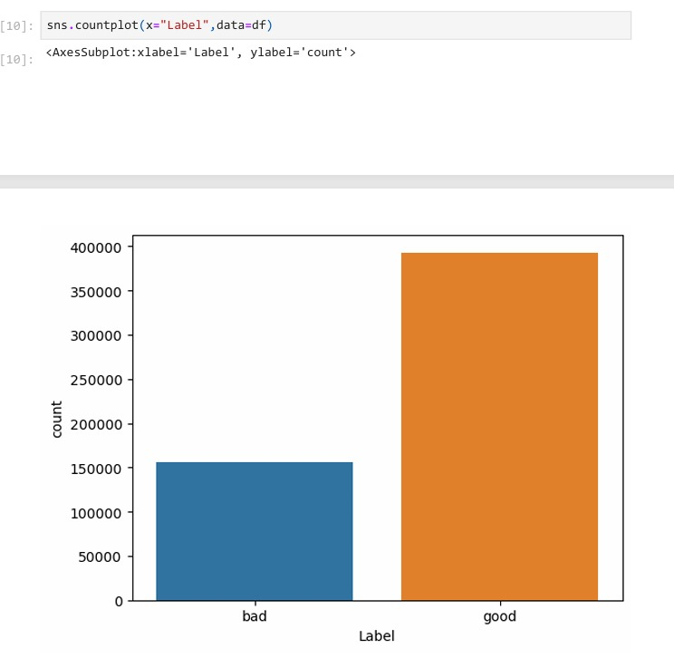
Design Modules
Collection of data
1.Phishing_urls_sites
Classification of good and bad URLs from given dataset.

Slide 9
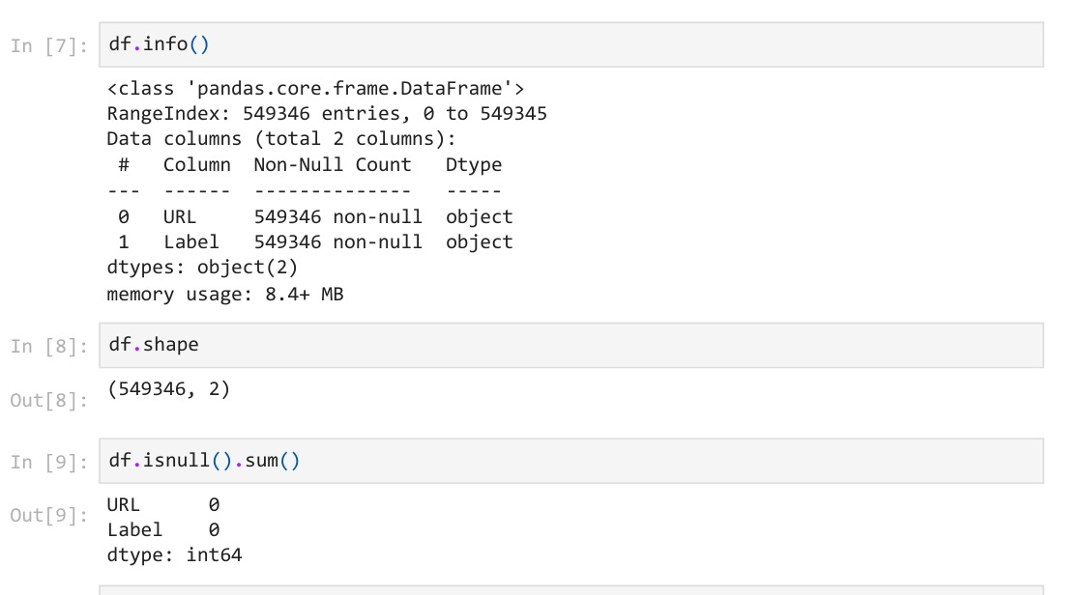
Processing And Cleaning Of Data
1.Removing of null values from both the datasets

Slide 10
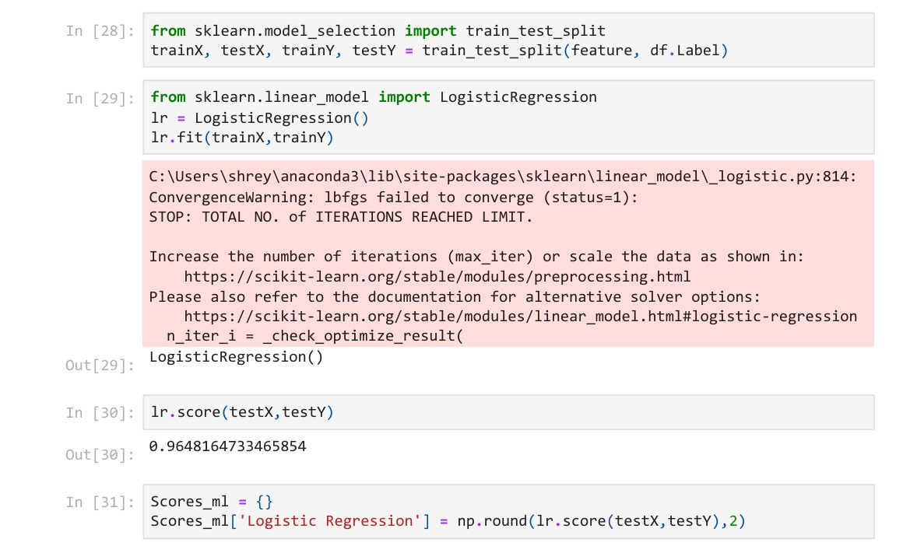
Demonstration
Code snippet and output for model creation and logistic regression

Slide 11
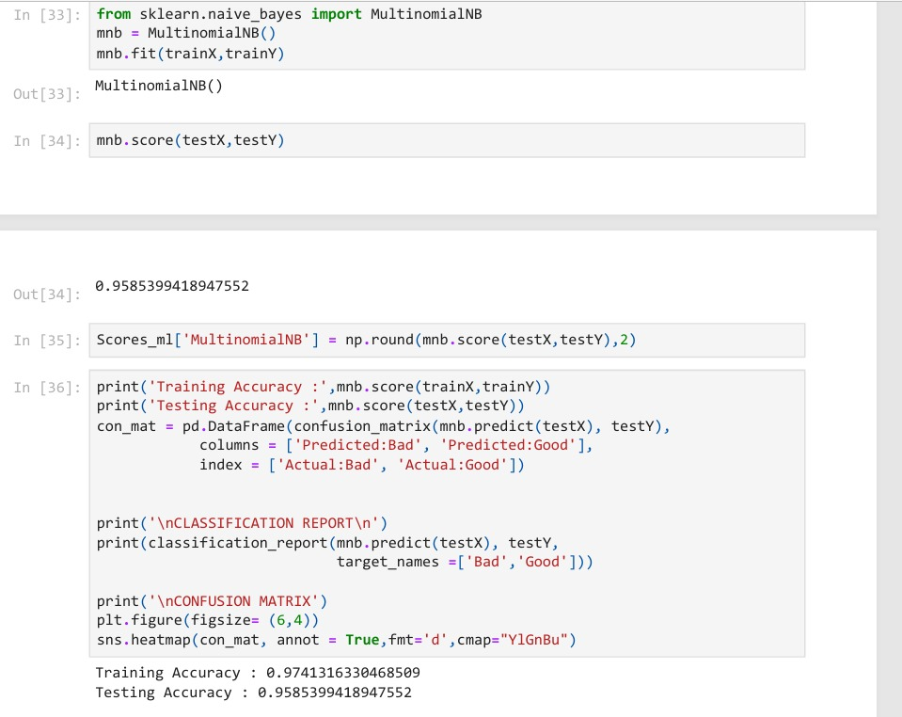
Code snippet and output for multinomial naive bayes

Slide 12
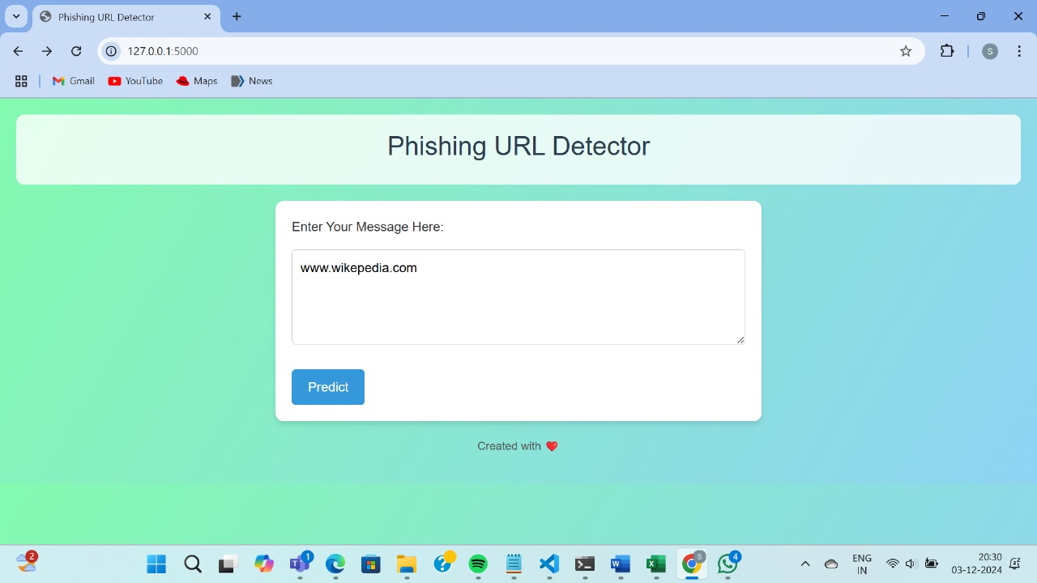

IMPLEMENTATION OF THE MODEL TO WEBSITE
WEBSITE ON GOOD URL

Slide 13
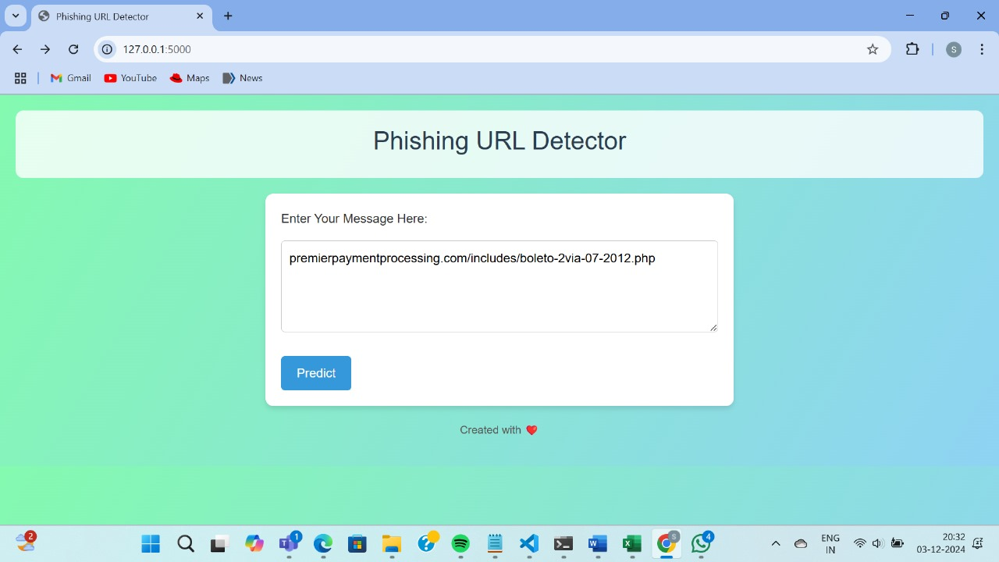

WEBSITE ON BAD URL

Slide 14
Conclusion
Phishing attack detection successfully applies machine learning techniques to detect and classify phishing attacks, offering a robust solution for identifying malicious websites. By analyzing key features such as URLs, domain names, and website content, the system effectively differentiates phishing sites from legitimate ones, even in the face of sophisticated attacks.
Key outcomes include:
Accurate detection of phishing sites while minimizing false positives.
Effective handling of advanced phishing techniques with high accuracy.
Scalable and automated solution capable of processing large datasets in real-time.
Contribution to enhancing cybersecurity by preventing data breaches and financial losses.
Improved user trust and protection against phishing threats.

Slide 15
References
[1] Manuj. Pillai 1, s. Ramya, and yongyun cho 2 v. DEVIKA1, SOMULA RAMASUBBAREDDY3,” evasion attacks and defence mechanisms for machine learning-based web phishing classifiers”.
[2] Abdul basit1 · maham zafar1 ·Xuan liu2 ·Abdul Rehman javed3 ·Zunera jalil3 ·Kashif kifayat3,” a comprehensive survey of ai-enabled phishing attacks detection techniques”, accepted: 9 October 2020 / published online: 23 October 2020©springer science+business media, llc, part of springer nature 2020.
[3] ashit Kumar dutta,” detecting phishing websites using machine learning technique”, department of computer science and information system, college of applied sciences, almaarefa university, riyadh, Saudi Arabia.

Slide 16
Thank you

